Slide 1
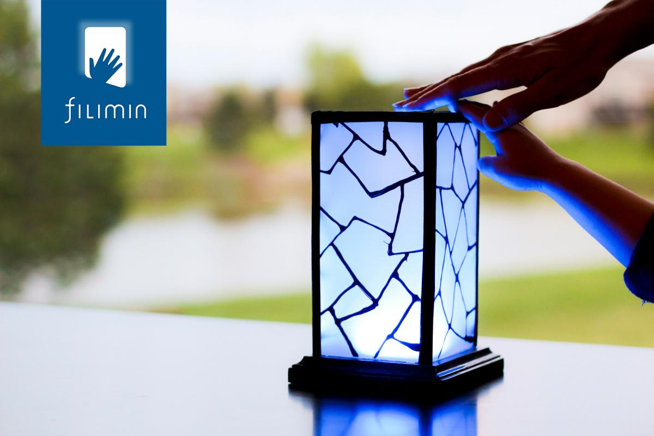
Filimin
...connects you with those you love,
no matter where they are in the world,
with a single touch...

Slide 2

Notes:
How do we connect meaningfully with those far away from us?
Phone
Verbal/text based
How do we connect meaningfully with those far away from us
How do we connect meaningfully with those far away from us

Slide 3

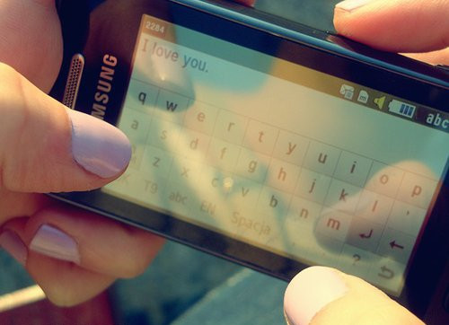


Slide 4

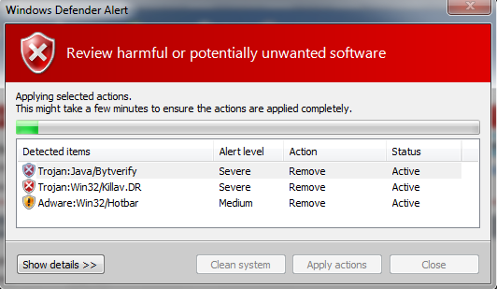
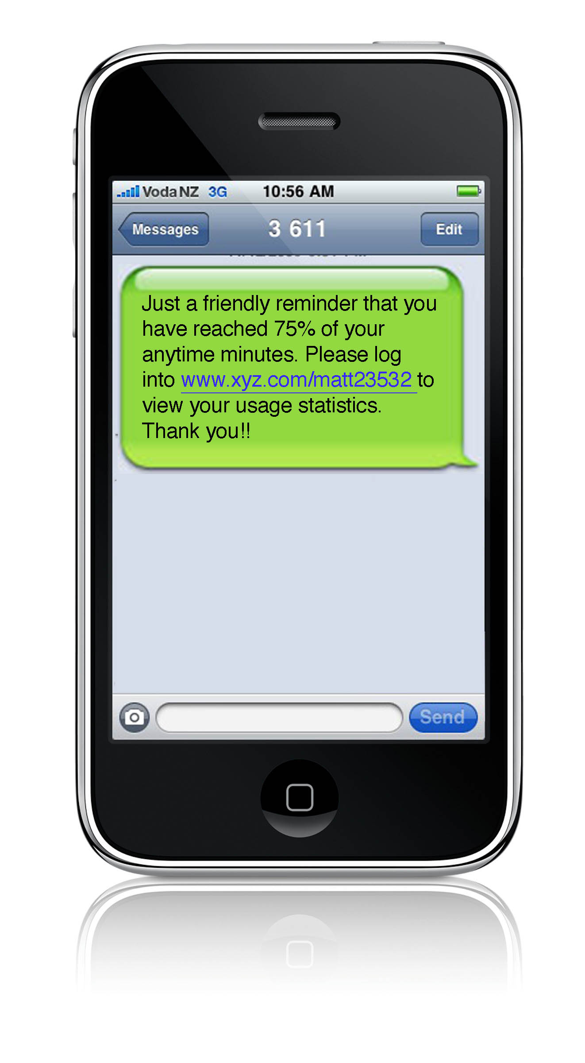
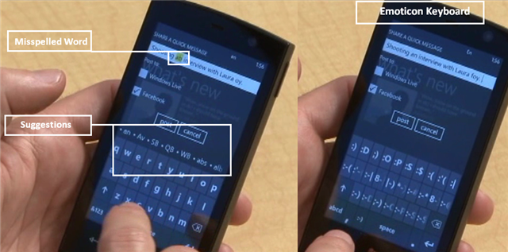
Notes:
Depends on advanced verbal, technical skills
Uses tools also used for appointments, to-do list, work, etc.

Slide 5


Notes:
How do we connect meaningfully with those far away from us?
Phone
Verbal/text based
How do we connect meaningfully with those far away from us
How do we connect meaningfully with those far away from us

Slide 6
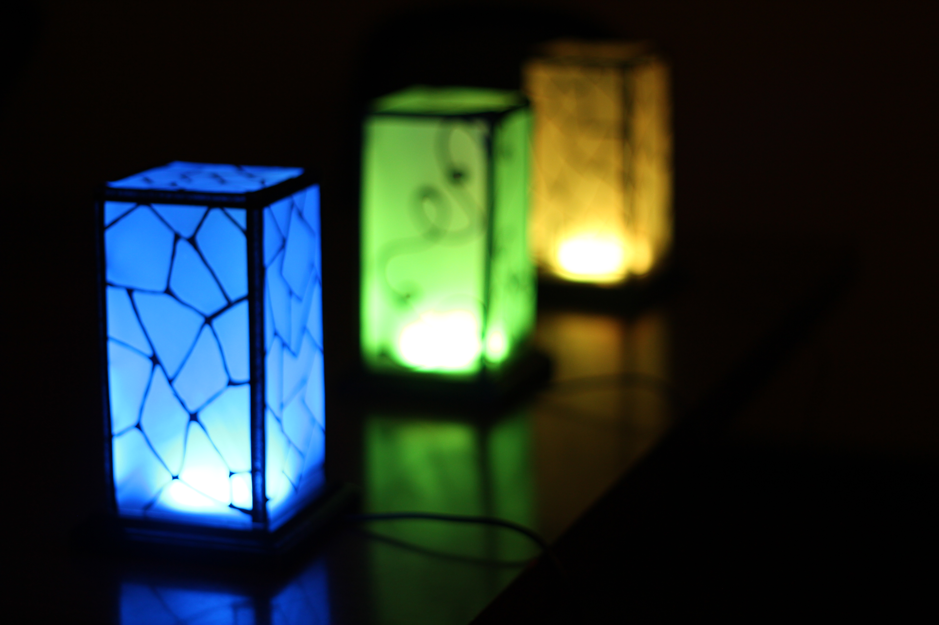
Notes:
Simple decorative touch lights
Connect easily to any wifi
No computer, no phone required
When one person touches their ligh, everybody's in the family lights
We know somebody is thinking of us.

Slide 7
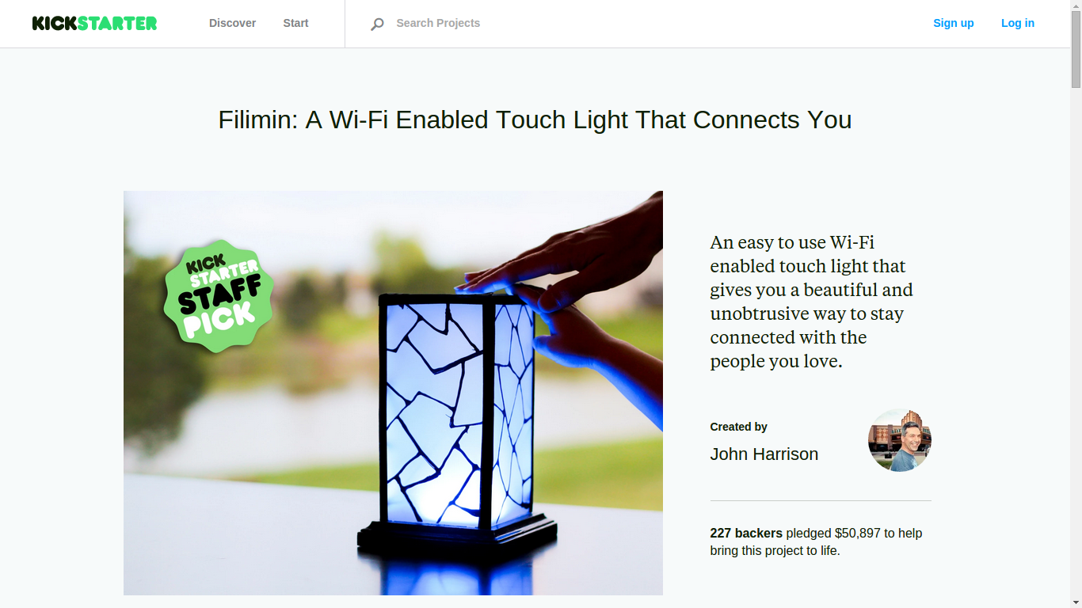

Slide 8
“My eldest son is off to college in August, and I thought this would be a really cool way to say, 'Hi!' without interrupting his day/evening. Just a little 'tap', as you say, to send him a smile.”

Slide 9
“I am an international student pursuing graduate studies over 5000 miles away from my parents and it would be a lovely way to feel some sort of connection with them”

Slide 10
“One will be here for our daughter, the other two will be at the grandparents houses as a way to keep in touch”

Slide 11
“I will give one to my mom and one to my brother, sister-in-law, and baby niece. We are all very close since my dad died two years ago, and my sister-in-law had twins last year. The thing about Filimin that intrigues me is how you might be passively aware of a person's presence, sort of like you might be aware of somebody you live with. I think it could be a continuous presence even in times that we don't really have much to say.”

Slide 12
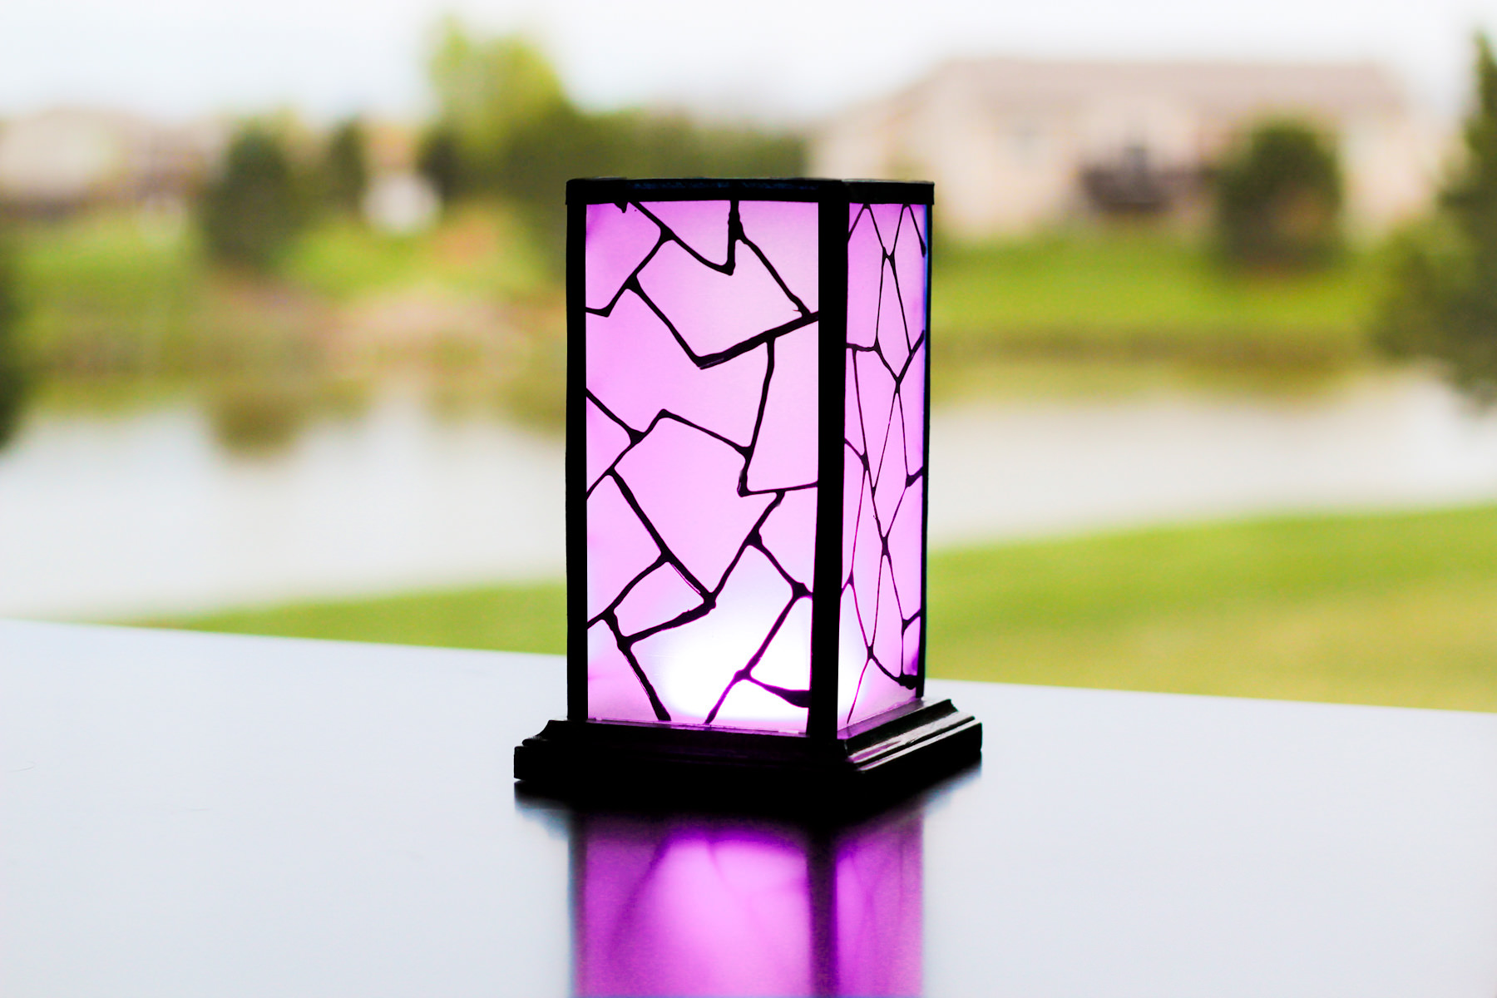
Kickstarter Stats
Monday raised
Preorders
Manufacturing qty
Delivery By
> $50,000
> 750
1,000
December 15

Slide 13
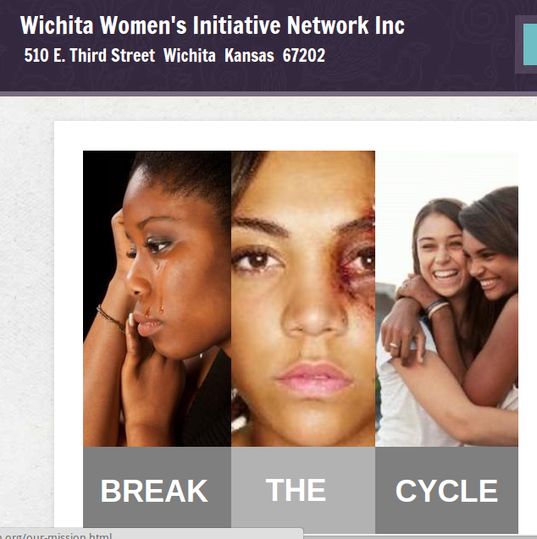
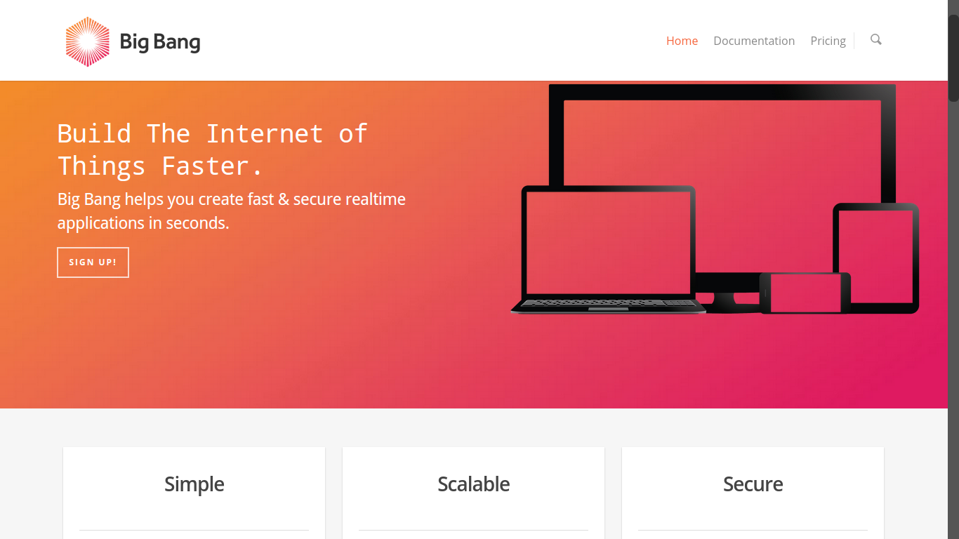
Partnerships

Slide 14
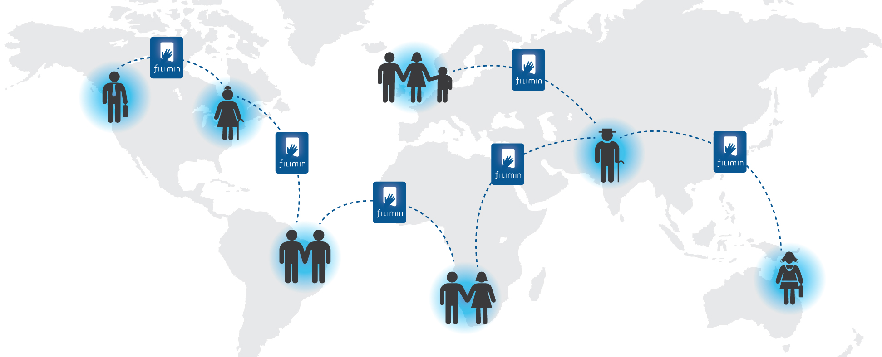
Delivery
Feedback
Samples
Target Market
Notes:
Satisfy current customers with on-time delivery of robust product
Have a great feedback system to learn from customs
Send samples to identify best target market

Slide 15
Wichita!

Slide 16
?

Slide 17
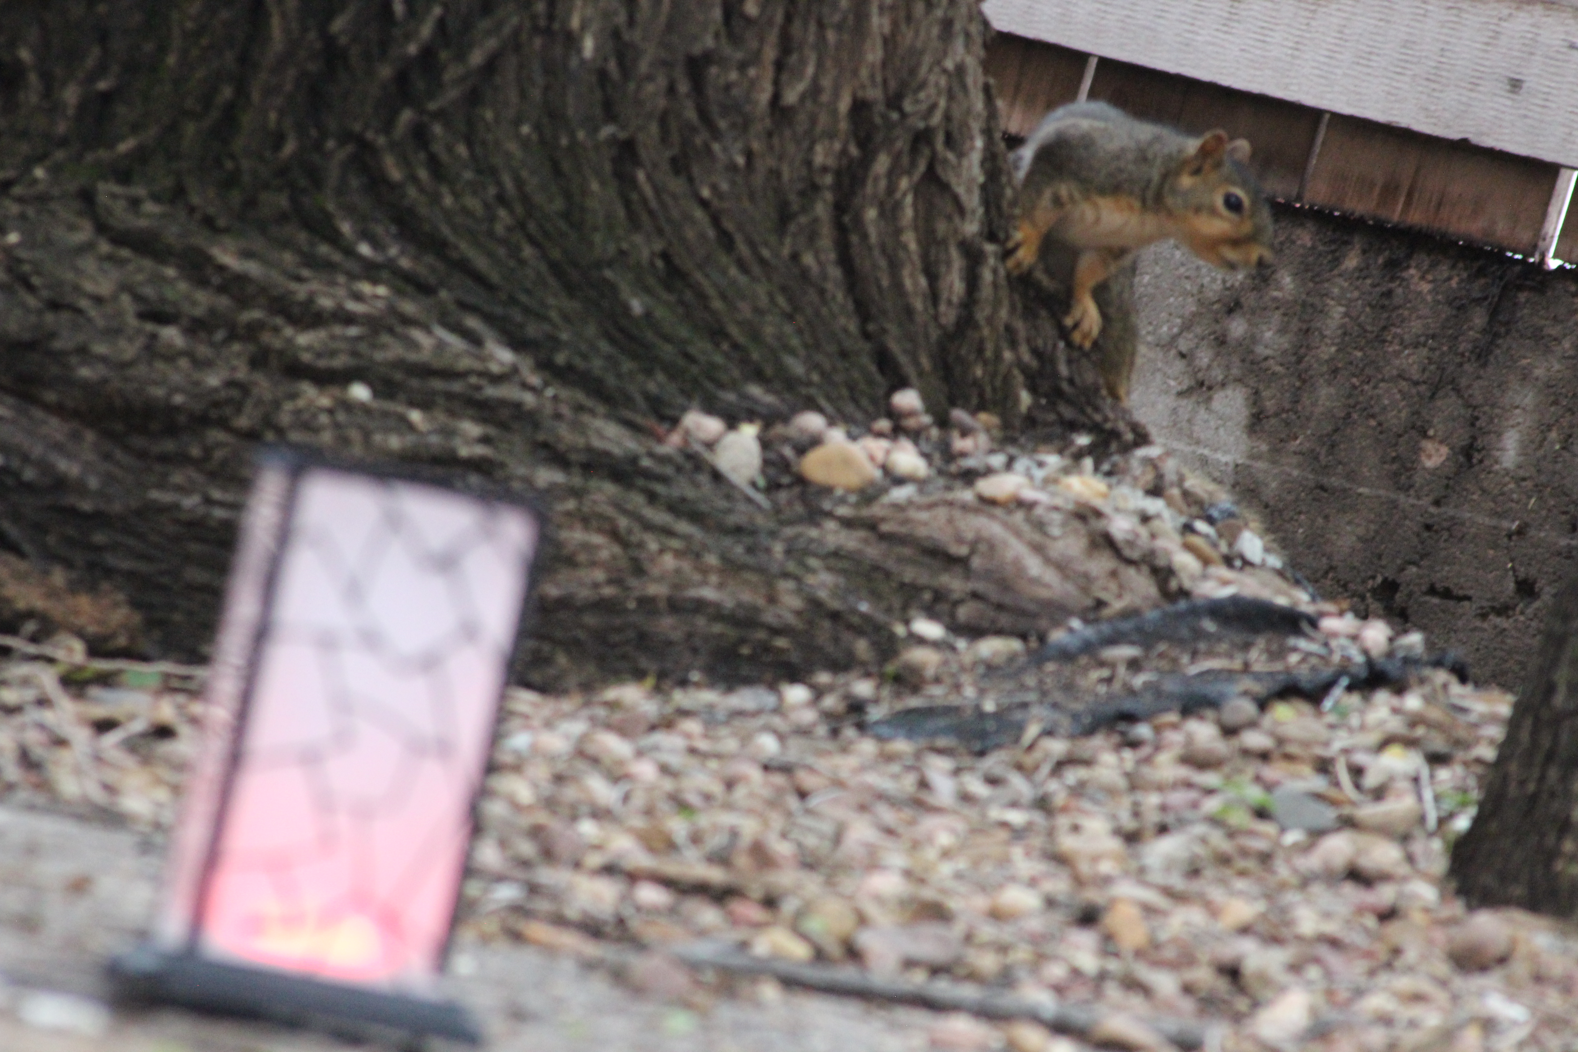
Help?
marketing
business plan
investment

